Slide 1
What is the strongest notion of regret that can be kept meaningfully sublinear in convex games?
Gabriele Farina
MIT
Paris, 2025

Slide 2
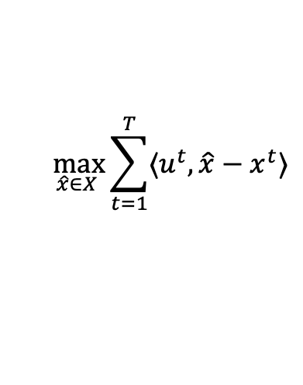
Regret minimization
External regret
$$\max_{\hat{x}∈X }{\sum_{t=1}^{T}{⟨u^{t}, \hat{x}−x^{t}⟩}}$$

Slide 3



Regret minimization
External regret
$$\max_{\hat{x}∈X }{\sum_{t=1}^{T}{⟨u^{t}, \hat{x}−x^{t}⟩}}$$
Always easy to guarantee sublinear on any convex compact set: projected gradient descent
$$X$$
$$x^{t}$$
$$x^{t+1}$$
Leads to coarse correl. equil.

Slide 4
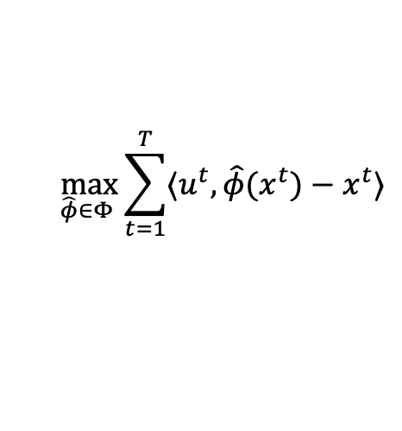
Regret minimization
External regret
$Φ$ regret
$$\max_{\hat{x}∈X }{\sum_{t=1}^{T}{⟨u^{t}, \hat{x}−x^{t}⟩}}$$
$$\max_{\hat{φ}∈Φ }{\sum_{t=1}^{T}{⟨u^{t}, \hat{φ}(x^{t})−x^{t}⟩}}$$
Always easy to guarantee sublinear on any convex compact set: projected gradient descent
$$X$$
$$x^{t}$$
$$x^{t+1}$$
Leads to coarse correl. equil.

Slide 5


Regret minimization
External regret
$Φ$ regret
$$\max_{\hat{x}∈X }{\sum_{t=1}^{T}{⟨u^{t}, \hat{x}−x^{t}⟩}}$$
$$\max_{\hat{φ}∈Φ }{\sum_{t=1}^{T}{⟨u^{t}, \hat{φ}(x^{t})−x^{t}⟩}}$$
Always easy to guarantee sublinear on any convex compact set: projected gradient descent
Larger $Φ$
Stronger notion of learning
Stronger notion of equilibrium
$$X$$
$$x^{t}$$
Swap regret: $Φ$ = all transformations $X→ X$. But in general we don’t know how to achieve that at a truly sublinear rate
$$x^{t+1}$$
What is the largest $Φ$ that is tractable in all games?
Leads to coarse correl. equil.

Slide 6
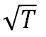
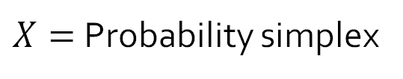
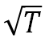
Normal-form games
$X=$ Probability simplex
External
Swap
Easy
Easy
$$\sqrt{T}$$
$$\sqrt{T}$$
Coarse correlated eq.
Correlated eq.
[E.g., Blum & Mansour, JMLR07 ; Hart & Mas-Colell Econometrica00]

Slide 7
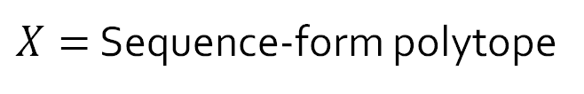
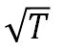
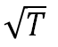
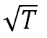
Sequential games
$X=$ Sequence-form polytope
External
Swap
Easy
(Coarse) trigger deviations
Linear transformations
Polynomial swap
Hard to online learn at meaningfully sublinear rate
$$\sqrt{T}$$
$$\sqrt{T}$$
$$\sqrt{T}$$
$$\sqrt{T}$$
[ZAFS NeurIPS24]
[DFGSZ 25]
Extensive form (coarse) correlated eq.
Linear correlated eq.
[FP NeurIPS23]
[FCMG JACM22]
[ZFS ICLR24]

Slide 8

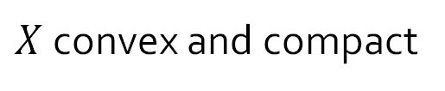
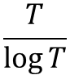
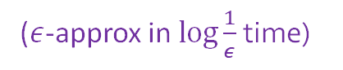


The general case
$X$ convex and compact
(Oracle access)
This talk
Recent exciting results (PTASes)
?
External
Swap
Easy
$$\frac{T}{\log{T}}$$
$$\sqrt{T}$$
Q1: What is the strongest notion of Phi-regret that is easy to keep under control efficiently?
This talk
(Meaningfully sublinear)
Q2: What is the strongest notion of Phi-equilibrium that can be computed efficiently?
($ε$-approx in $\log{\frac{1}{ε}}$ time)

Slide 9
Spilling the 🫘
Linear swap regret
Quite technically involved!
[DFFPS STOC25]
Results
Techniques

Slide 10
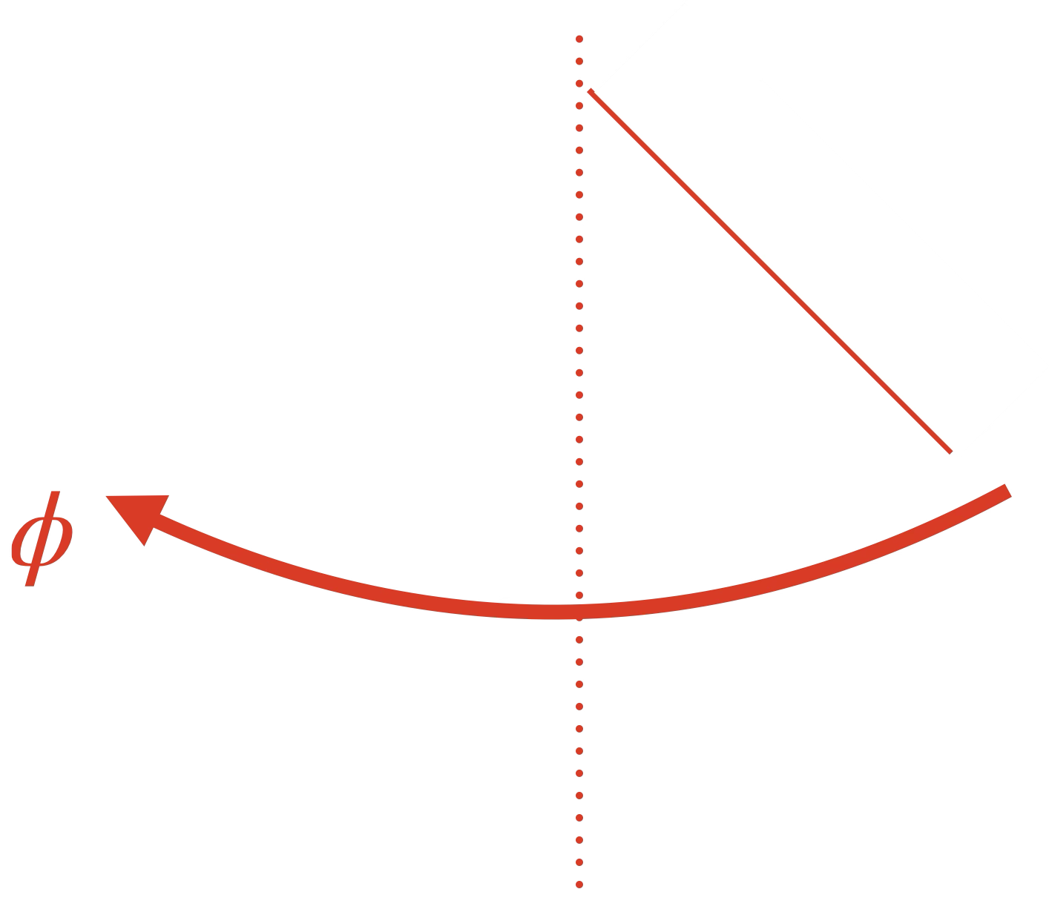
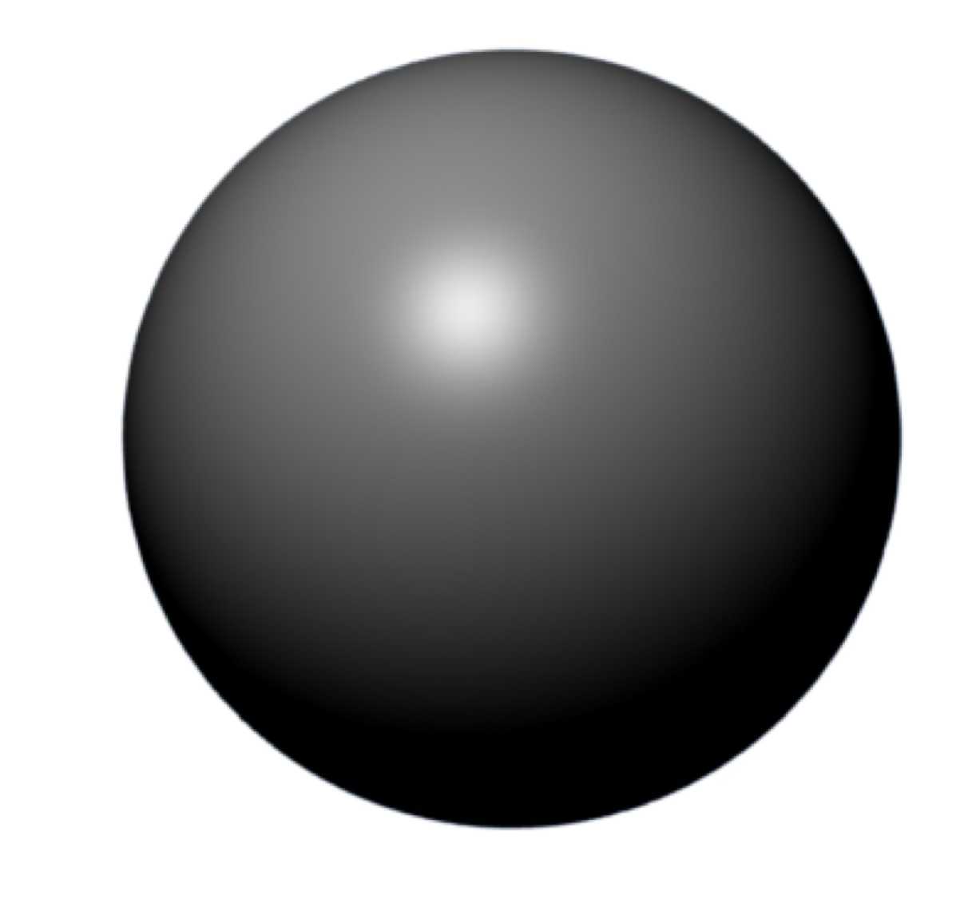
Spilling the 🫘
Linear swap regret
Quite technically involved!
Optimization & separation over endomorphisms is hard
[DFFPS STOC25]
Results
Techniques

Slide 11
Spilling the 🫘
Linear swap regret
Quite technically involved!
Optimization & separation over endomorphisms is hard
[DFFPS STOC25]
Results
Techniques

Slide 12
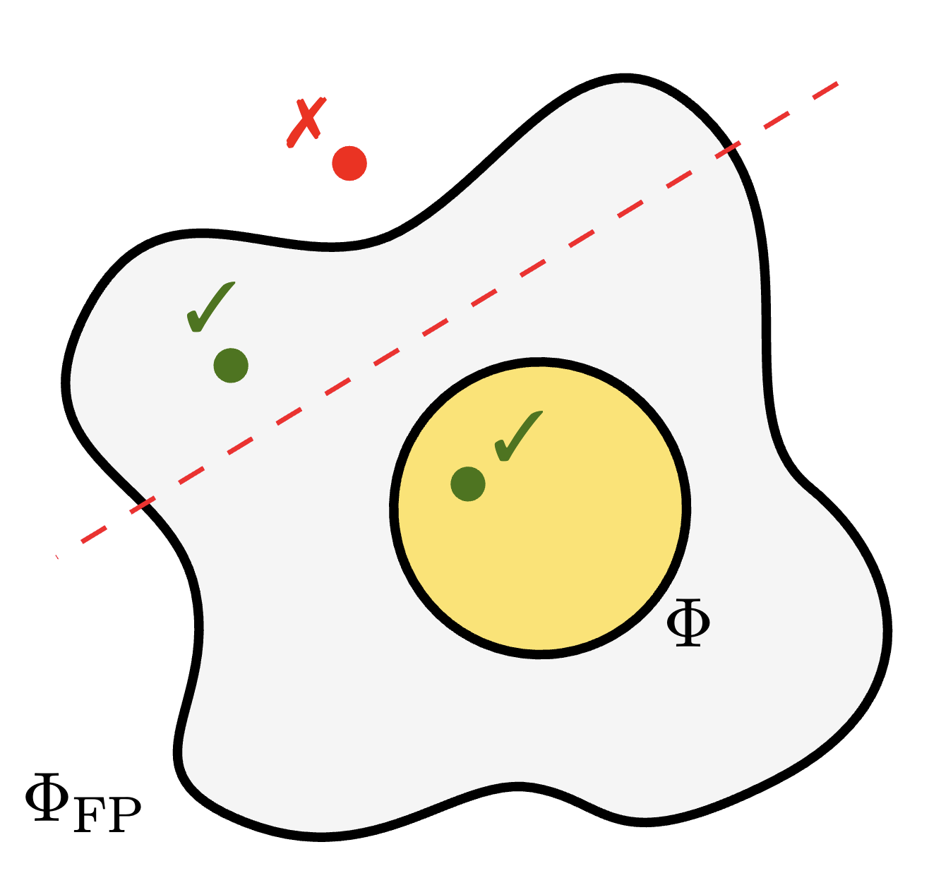
Spilling the 🫘
Linear swap regret
Quite technically involved!
Optimization & separation over endomorphisms is hard
[DFFPS STOC25]
Efficient learning & computation
🛠️ Semiseparation (independent interest / uses)
Results
1
Techniques
Unusual situation: we can minimize linear swap regret, but not measure it!

Slide 13
Spilling the 🫘
Linear swap regret
Quite technically involved!
Optimization & separation over endomorphisms is hard
[DFFPS STOC25]
Efficient learning & computation
🛠️ Semiseparation (independent interest / uses)
Results
1
Profile swap regret
Techniques
[ACMMSS EC25]
Unusual situation: we can minimize linear swap regret, but not measure it!
Efficient learning

Slide 14
Spilling the 🫘
Linear swap regret
Quite technically involved!
Optimization & separation over endomorphisms is hard
[DFFPS STOC25]
Efficient learning & computation
🛠️ Semiseparation (independent interest / uses)
Results
1
Profile swap regret
Techniques
[ACMMSS EC25]
Unusual situation: we can minimize linear swap regret, but not measure it!
Efficient learning
Low-degree polynomial swap
🛠️ Expected fixed points
2
[ZATBFCS EC25]
Efficient learning & computation

Slide 15
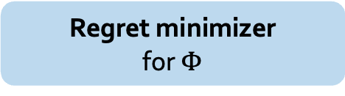
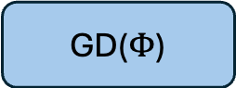
GGM’s construction
[Gordon, Greenwald & Marks, ICML08]
Reduces: $Φ$-regret minimization on $X$ $→$ external regret minimization on $Φ$
$Φ$-Regret minimizer for $X$
GD($Φ$)
Regret minimizer
for $Φ$
1

Slide 16

GGM’s construction
[Gordon, Greenwald & Marks, ICML08]
Reduces: $Φ$-regret minimization on $X$ $→$ external regret minimization on $Φ$
$Φ$-Regret minimizer for $X$
GD($Φ$)
$$φ^{t}$$
Regret minimizer
for $Φ$
1

Slide 17
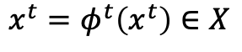
GGM’s construction
[Gordon, Greenwald & Marks, ICML08]
Reduces: $Φ$-regret minimization on $X$ $→$ external regret minimization on $Φ$
$Φ$-Regret minimizer for $X$
GD($Φ$)
$$φ^{t}$$
$$x^{t}=φ^{t}\left(x^{t}\right)∈X$$
Fixed point oracle
2
Regret minimizer
for $Φ$
1

Slide 18
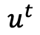

GGM’s construction
[Gordon, Greenwald & Marks, ICML08]
Reduces: $Φ$-regret minimization on $X$ $→$ external regret minimization on $Φ$
$Φ$-Regret minimizer for $X$
$$u^{t}$$
$$u^{t}⊗x^{t}$$
GD($Φ$)
$$φ^{t}$$
$$x^{t}=φ^{t}\left(x^{t}\right)∈X$$
Fixed point oracle
2
Regret minimizer
for $Φ$
1

Slide 19
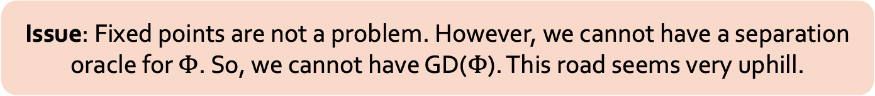
GGM’s construction
[Gordon, Greenwald & Marks, ICML08]
Reduces: $Φ$-regret minimization on $X$ $→$ external regret minimization on $Φ$
$Φ$-Regret minimizer for $X$
$$u^{t}$$
$$u^{t}⊗x^{t}$$
GD($Φ$)
$$φ^{t}$$
$$x^{t}=φ^{t}\left(x^{t}\right)∈X$$
Fixed point oracle
2
Regret minimizer
for $Φ$
1
Issue: Fixed points are not a problem. However, we cannot have a separation oracle for $Φ$. So, we cannot have GD($Φ$). This road seems very uphill.

Slide 20
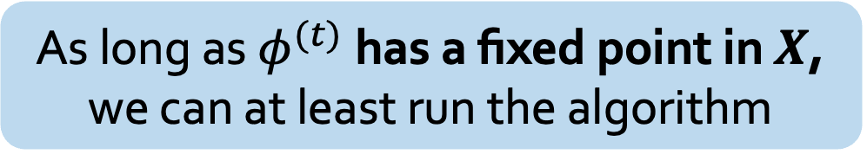
Semiseparation
[DFFPS STOC25]
As long as $φ^{(t)}$ has a fixed point in $X$, we can at least run the algorithm

Slide 21

Semiseparation
[DFFPS STOC25]
As long as $φ^{(t)}$ has a fixed point in $X$, we can at least run the algorithm
We can perhaps relax the condition of $φ^{(t)}$ being an endomorphism, and only check if it admits a fixed point

Slide 22
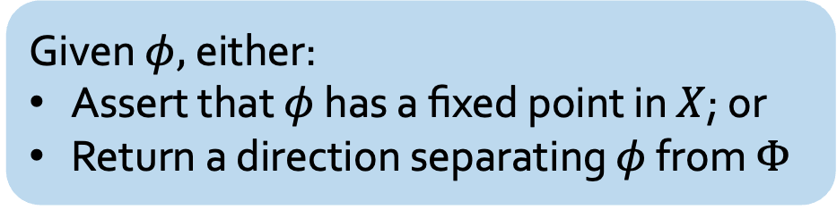
Semiseparation
[DFFPS STOC25]
A convex yolk on which membership is hard
As long as $φ^{(t)}$ has a fixed point in $X$, we can at least run the algorithm
We can perhaps relax the condition of $φ^{(t)}$ being an endomorphism, and only check if it admits a fixed point
Semiseparation oracle
Given $φ,$either:
Assert that $φ$ has a fixed point in $X$; or
Return a direction separating $φ$ from $Φ$
A nonconvex white on which membership is easy

Slide 23
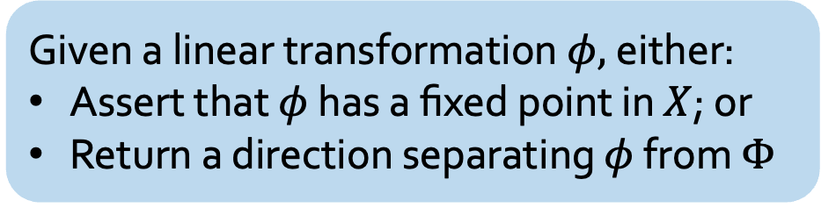
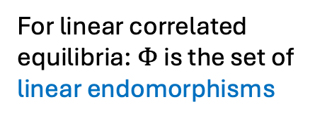
Constructing the semiseparation oracle
[DFFPS STOC25]
Given a linear transformation $φ,$either:
Assert that $φ$ has a fixed point in $X$; or
Return a direction separating $φ$ from $Φ$
For linear correlated equilibria: $Φ$ is the set of linear endomorphisms

Slide 24
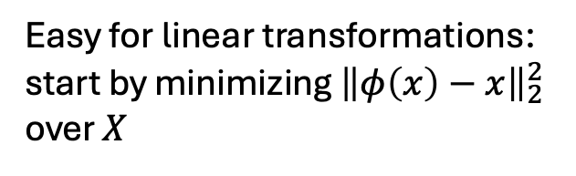
Constructing the semiseparation oracle
[DFFPS STOC25]
Given a linear transformation $φ,$either:
Assert that $φ$ has a fixed point in $X$; or
Return a direction separating $φ$ from $Φ$
For linear correlated equilibria: $Φ$ is the set of linear endomorphisms
Easy for linear transformations: start by minimizing ${\left\|φ\left(x\right)−x\right\|}_{2}^{2}$ over $X$

Slide 25
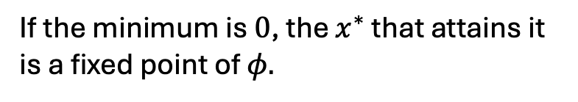
Constructing the semiseparation oracle
[DFFPS STOC25]
Given a linear transformation $φ,$either:
Assert that $φ$ has a fixed point in $X$; or
Return a direction separating $φ$ from $Φ$
For linear correlated equilibria: $Φ$ is the set of linear endomorphisms
If the minimum is $0$, the $x^{∗}$ that attains it is a fixed point of $φ.$
Easy for linear transformations: start by minimizing ${\left\|φ\left(x\right)−x\right\|}_{2}^{2}$ over $X$

Slide 26
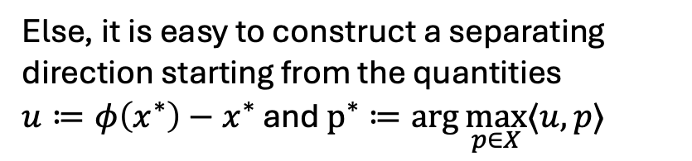
Constructing the semiseparation oracle
[DFFPS STOC25]
Given a linear transformation $φ,$either:
Assert that $φ$ has a fixed point in $X$; or
Return a direction separating $φ$ from $Φ$
For linear correlated equilibria: $Φ$ is the set of linear endomorphisms
If the minimum is $0$, the $x^{∗}$ that attains it is a fixed point of $φ.$
Easy for linear transformations: start by minimizing ${\left\|φ\left(x\right)−x\right\|}_{2}^{2}$ over $X$
Else, it is easy to construct a separating direction starting from the quantities
$u≔φ\left(x^{∗}\right)−x^{∗}$ and $p^{∗}≔\arg{\max_{p∈X}{⟨u,p⟩}}$

Slide 27
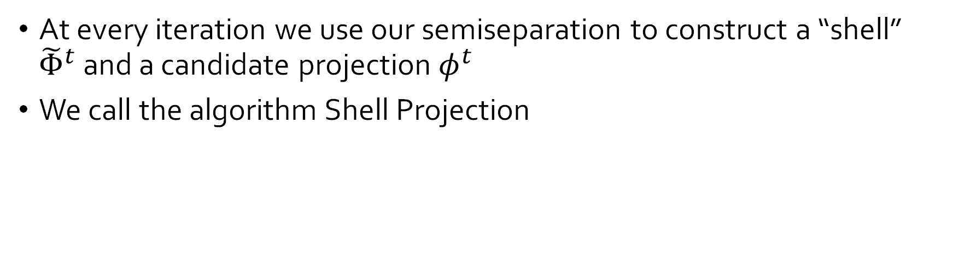
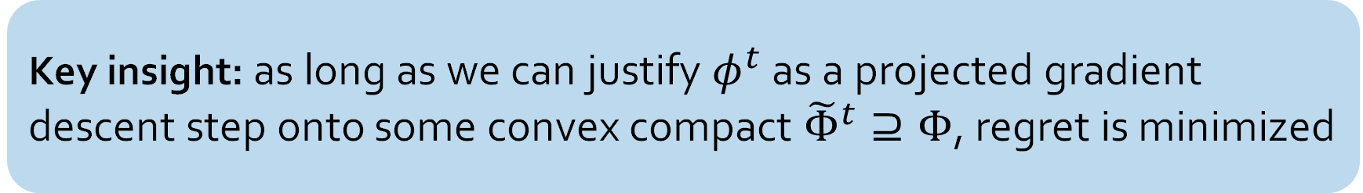
Using the semiseparation oracle
[DFFPS STOC25]
Key insight: as long as we can justify $φ^{t}$ as a projected gradient descent step onto some convex compact ${\tilde{Φ}}^{t}⊇Φ$, regret is minimized
At every iteration we use our semiseparation to construct a “shell” ${\tilde{Φ}}^{t}$ and a candidate projection $φ^{t}$
We call the algorithm Shell Projection

Slide 28
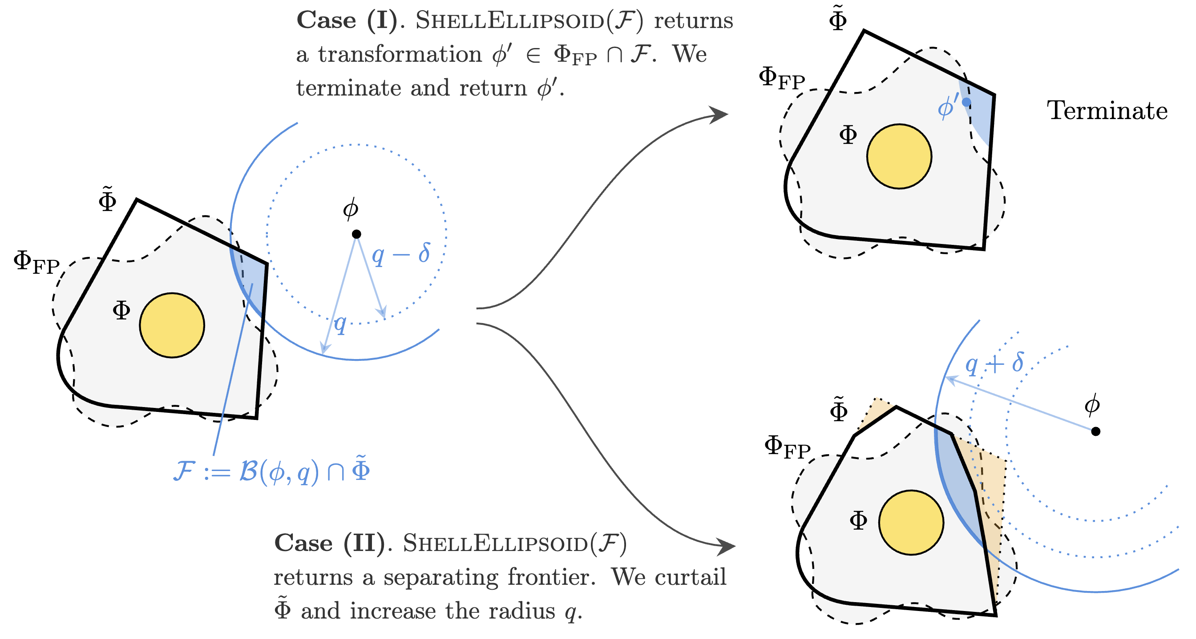
The algorithm’s idea
[DFFPS STOC25]

Slide 29
From learning to efficient equilibrium computation
One cool fact: The same ingredients as the GGM construction suffice to construct a log(1/eps) algorithm for computing eps-approximate equilibria
Idea: a general computational version of the minimax theorem [Farina & Pipis, NeurIPS23]
This extends the EAH algorithm [Papadimitriou & Roughgarden JACM’08] to general convex settings, even when the polynomial type property is violated

Slide 30
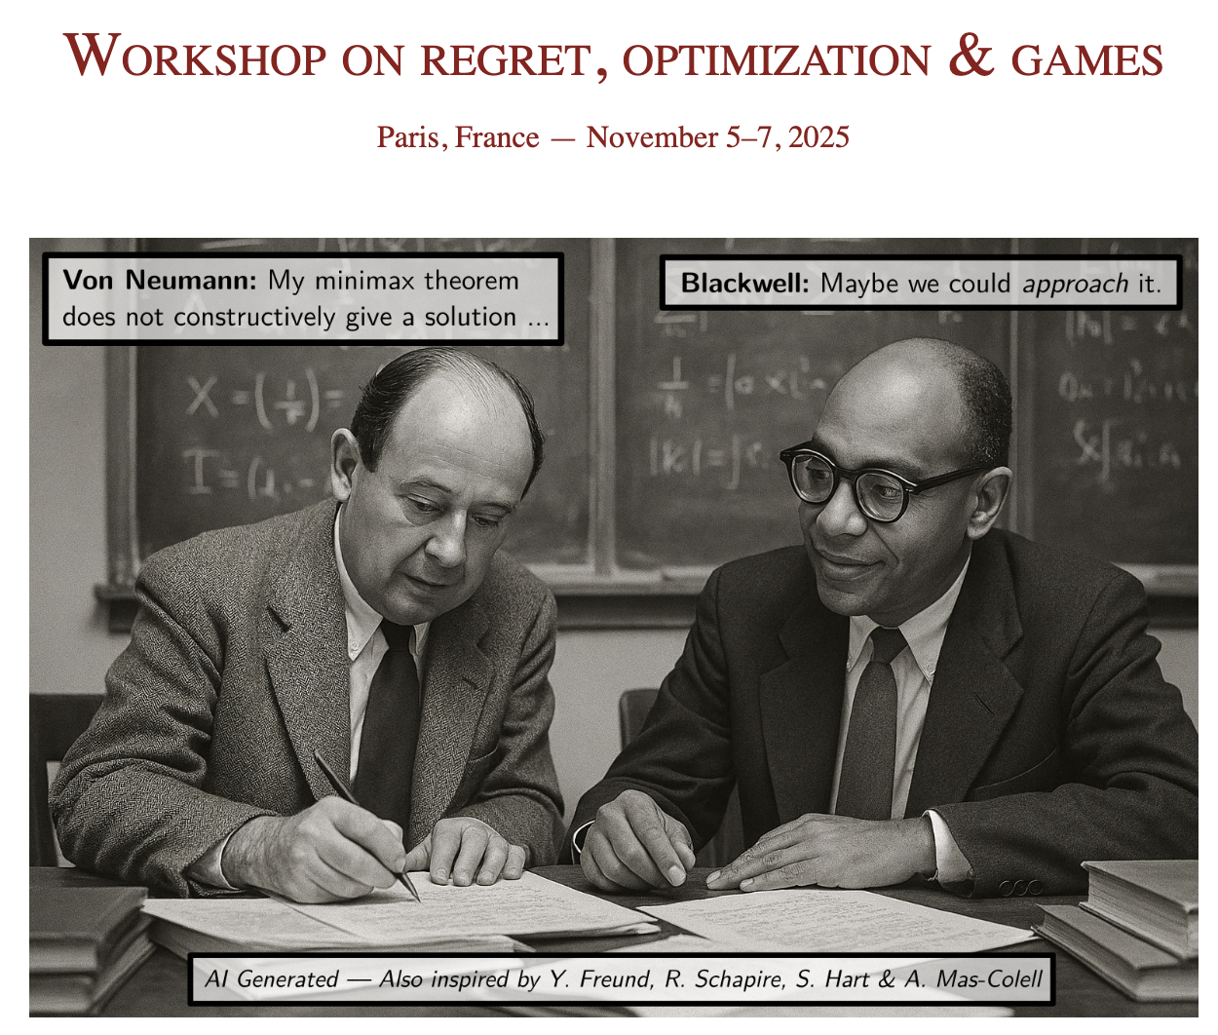

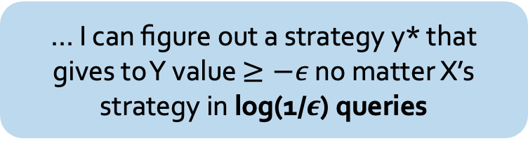
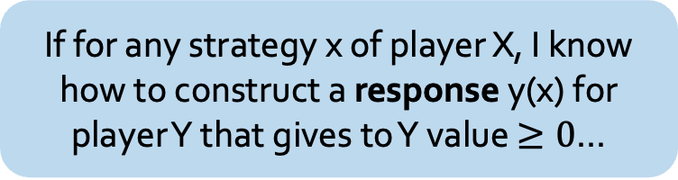
A faster approach:
If for any strategy x of player X, I know how to construct a response y(x) for player Y that gives to Y value $≥0$…
… I can figure out a strategy y* that gives to Y value $≥−ε$ no matter X’s strategy in log(1/$ε$) queries
(Instead of Blackwell’s poly(1/$ε$) guarantee!)

Slide 31
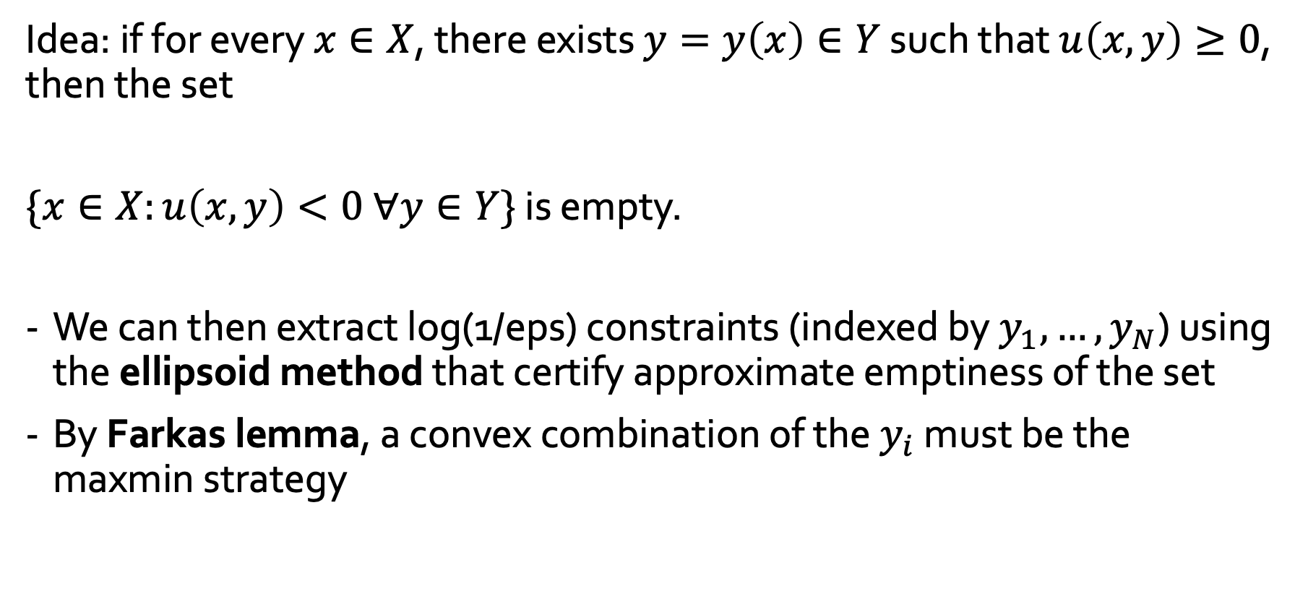
Sketch of proof
Idea: if for every $x∈X$, there exists $y=y\left(x\right)∈Y$ such that $u\left(x, y\right)≥0$, then the set
$\{x∈X:u\left(x, y\right)<0 ∀y∈Y\}$ is empty.
We can then extract log(1/eps) constraints (indexed by $y_{1},…,y_{N}$) using the ellipsoid method that certify approximate emptiness of the set
By Farkas lemma, a convex combination of the $y_{i}$ must be the maxmin strategy

Slide 32
The extension to low-degree polynomials
Can we use low-degree polynomials instead of linear endomorphisms?
[ZATBFCS EC25]

Slide 33

The extension to low-degree polynomials
Can we use low-degree polynomials instead of linear endomorphisms?
Not if we insist on fixed points $φ\left(x\right)=x$!
[ZATBFCS EC25]

Slide 34
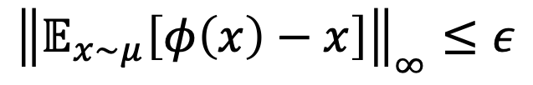
The extension to low-degree polynomials
Can we use low-degree polynomials instead of linear endomorphisms?
Not if we insist on fixed points $φ\left(x\right)=x$!
But yes if we are willing to use expected fixed points!
$${\left\|𝔼_{x∼μ}\left[φ\left(x\right)−x\right]\right\|}_{∞}≤ε$$
[ZATBFCS EC25]

Slide 35
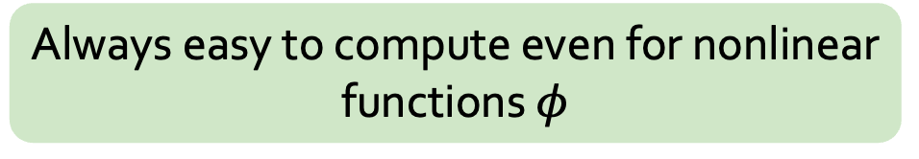
The extension to low-degree polynomials
Can we use low-degree polynomials instead of linear endomorphisms?
Not if we insist on fixed points $φ\left(x\right)=x$!
But yes if we are willing to use expected fixed points!
$${\left\|𝔼_{x∼μ}\left[φ\left(x\right)−x\right]\right\|}_{∞}≤ε$$
Always easy to compute even for nonlinear functions $φ$
[ZATBFCS EC25]

Slide 36

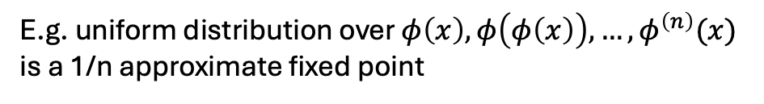
The extension to low-degree polynomials
Can we use low-degree polynomials instead of linear endomorphisms?
Not if we insist on fixed points $φ\left(x\right)=x$!
Image credit: iStock
But yes if we are willing to use expected fixed points!
$${\left\|𝔼_{x∼μ}\left[φ\left(x\right)−x\right]\right\|}_{∞}≤ε$$
Always easy to compute even for nonlinear functions $φ$
E.g. uniform distribution over $φ\left(x\right),φ\left(φ\left(x\right)\right), …, φ^{\left(n\right)}(x)$ is a 1/n approximate fixed point
In fact, we can also do poly(d, log(1/eps)) time,
using another instance of the EAH algorithm
[ZATBFCS EC25]

Slide 37
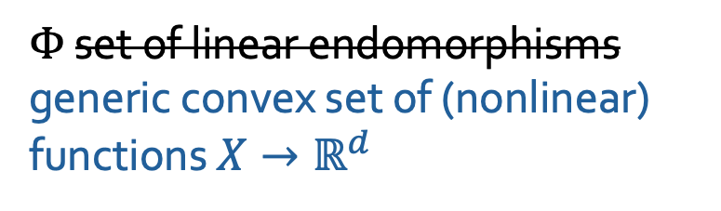
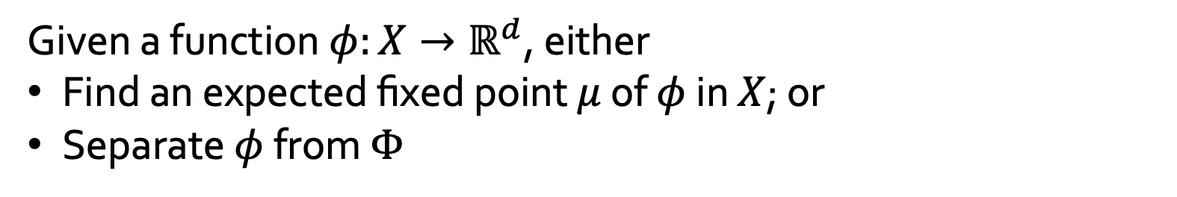
The extension to nonlinear transformations
Nonlinear semiseparation oracle
$Φ$ set of linear endomorphisms generic convex set of (nonlinear) functions $X→ℝ^{d}$
Given a function $φ:X→ℝ^{d}$, either
Find an expected fixed point $μ$ of $φ$ in $X$; or
Separate $φ$ from $Φ$
Can be implemented poly(d, log(1/eps)) time!
[ZATBFCS EC25]

Slide 38
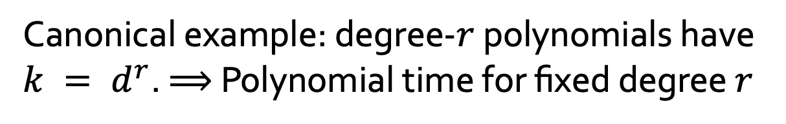
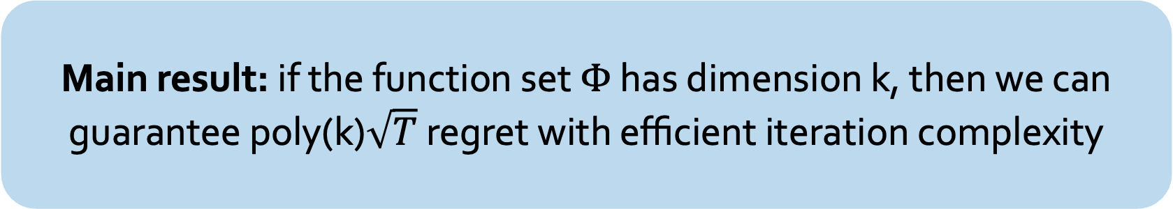
The extension to nonlinear transformations
Main result: if the function set $Φ$ has dimension k, then we can guarantee poly(k)$\sqrt{T}$ regret with efficient iteration complexity
Canonical example: degree-$r$ polynomials have $k = d^{r}$. $⟹$ Polynomial time for fixed degree $r$
External
Swap
Interpolation
[ZATBFCS EC25]

Slide 39
Beyond games
Two more uses of this machinery

Slide 40
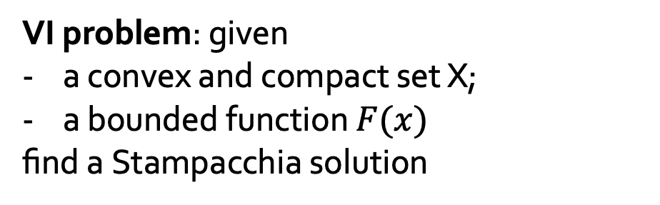
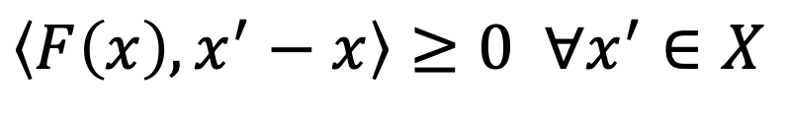
“Expected” VI solutions
[ZATBFCS ICML25]
VI problem: given
a convex and compact set X;
a bounded function $F(x)$
find a Stampacchia solution
$$\left\langle F\left(x\right), x^{′}−x\right\rangle ≥0 ∀x^{′}∈X$$
When F(x) = gradient f(x), this captures first-order optimality conditions for f(x)
Nash equilibria are captured already for F(x) linear
Computationally hard in general

Slide 41
“Expected” VI solutions
[ZATBFCS ICML25]
VI problem: given
a convex and compact set X;
a bounded function $F(x)$
find a Stampacchia solution
$$\left\langle F\left(x\right), x^{′}−x\right\rangle ≥0 ∀x^{′}∈X$$
When F(x) = gradient f(x), this captures first-order optimality conditions for f(x)
Nash equilibria are captured already for F(x) linear
Computationally hard in general
If VIs capture Nash equilibria, what is the natural equivalent of (coarse) correlated equilibria, and can we inherit all the nice computational benefits?

Slide 42
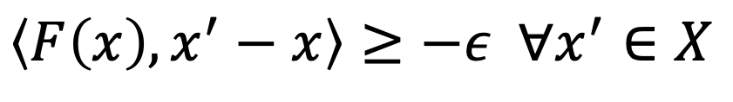
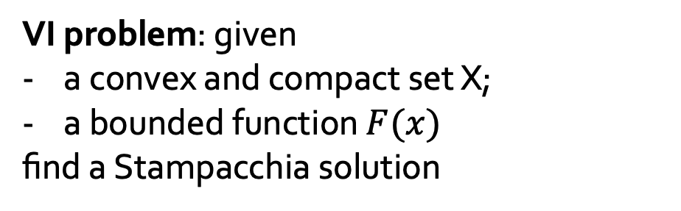
“Expected” VI solutions
[ZATBFCS ICML25]
VI problem: given
a convex and compact set X;
a bounded function $F(x)$
find a Stampacchia solution
$$\left\langle F\left(x\right), x^{′}−x\right\rangle ≥−ε ∀x^{′}∈X$$

Slide 43
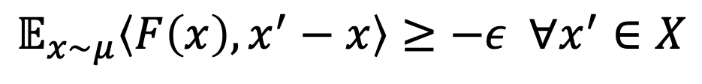
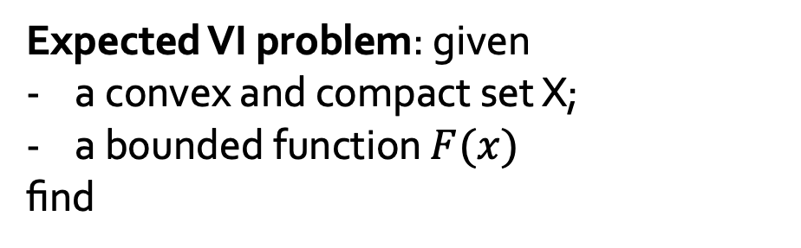
“Expected” VI solutions
[ZATBFCS ICML25]
VI problem: given
a convex and compact set X;
a bounded function $F(x)$
find a Stampacchia solution
$$\left\langle F\left(x\right), x^{′}−x\right\rangle ≥−ε ∀x^{′}∈X$$
Expected VI problem: given
a convex and compact set X;
a bounded function $F(x)$
find
$$𝔼_{x∼μ}\left\langle F\left(x\right), x^{′}−x\right\rangle ≥−ε ∀x^{′}∈X$$

Slide 44
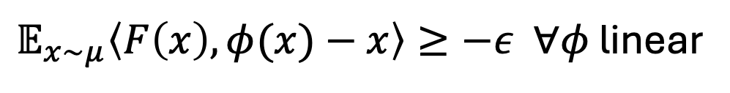
“Expected” VI solutions
[ZATBFCS ICML25]
VI problem: given
a convex and compact set X;
a bounded function $F(x)$
find a Stampacchia solution
$$\left\langle F\left(x\right), x^{′}−x\right\rangle ≥−ε ∀x^{′}∈X$$
Expected VI problem: given
a convex and compact set X;
a bounded function $F(x)$
find
$$𝔼_{x∼μ}\left\langle F\left(x\right), x^{′}−x\right\rangle ≥−ε ∀x^{′}∈X$$
$𝔼_{x∼μ}\left\langle F\left(x\right),φ(x)−x\right\rangle ≥−ε ∀φ$ linear
Can be solved in poly(log(1/eps), dimension) time

Slide 45
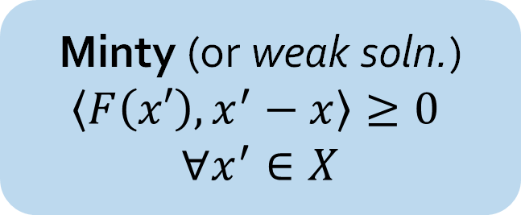
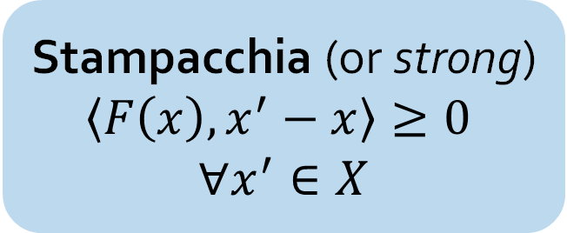
Polynomial-time solution of VIs with Minty points
Stampacchia (or strong)
$$\left\langle F\left(x\right), x^{′}−x\right\rangle ≥0$$
$$∀x^{′}∈X$$
Membership in nonconvex set (Stampacchia solutions)
-- The “yolk”
Minty (or weak soln.)
$$\left\langle F\left(x′\right), x^{′}−x\right\rangle ≥0$$
$$∀x^{′}∈X$$
Separation from convex set (Minty solutions)
-- the “white”
[AFSZ preprint 25]

Slide 46
Polynomial-time solution of VIs with Minty points
Main result: If F is continuous and a Minty solution exists, then it is possible to compute a Stampacchia solution in log(1/eps) time
Several corollaries including a poly-time algorithm for minimization of quasar-convex functions
[AFSZ preprint 25]

Slide 47
Polynomial-time solution of VIs with Minty points
Main result: If F is continuous and a Minty solution exists, then it is possible to compute a Stampacchia solution in log(1/eps) time
Several corollaries including a poly-time algorithm for minimization of quasar-convex functions
Unexpected consequence: in two-player games, it is tractable to either find a Nash equilibrium or a strongly incentive-compatible coarse correlated equilibrium. Each problem is by itself hard.
[AFSZ preprint 25]

Slide 48

Wrapping up
?
External
Swap
What is the strongest notion of regret that we can efficiently keep under control?
What is the closes to correlated equilibrium that we can compute beyond normal-form games?
Touches a deeper core
Semi-separation as a pretty versatile primitive
Questions about the geometry of endomorphism
Applications beyond games to optimization at large

Slide 49







The students that make this possible
Charis
Emanuel
Max
Brian
Emin
Ioannis
Noah

Slide 50

Questions?

